Slide 1
AI Document processing for automating business process
TEAM – DB KRONOS
MARCH 2022

Slide 2
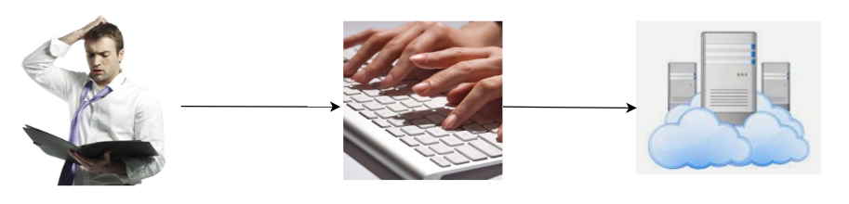




Problems with manual Document Processing
~$320 Bn
90 %
70 %
30 %
Compliance operation costs/fines paid over the last decade
Delay observed in turn around time (TAT)
Manual efforts required for document processing
Error introduced due to manual intervention
LEGAL
LOAN
KYC
MORTGAGE
SETTLEMENT
OPERATIONS

Slide 3
How are we solving the problem?
NLP based machine learning model.
Automated Entity Extraction.
Automated annotations which will enable easy traceability.
Supports documents in format like images, pdf.
OCR capability.
Supports various outputs including text, audio.

Slide 4
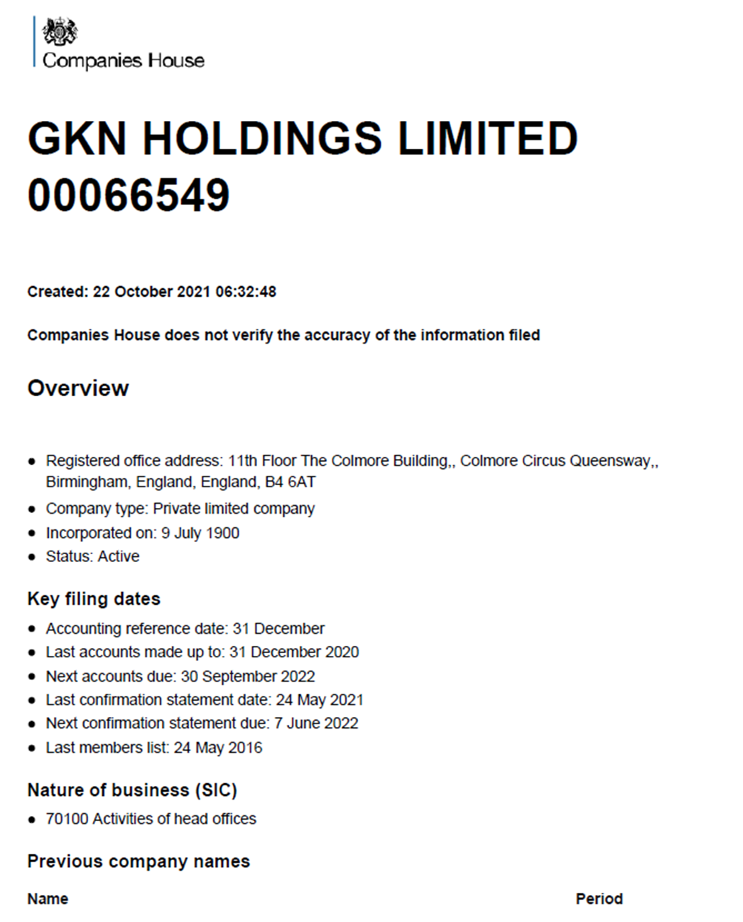
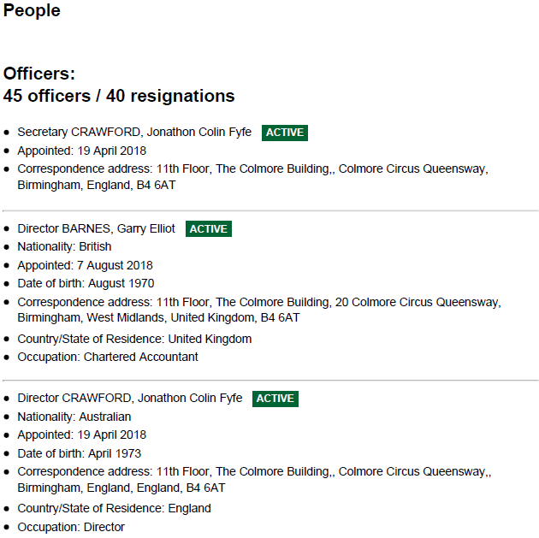
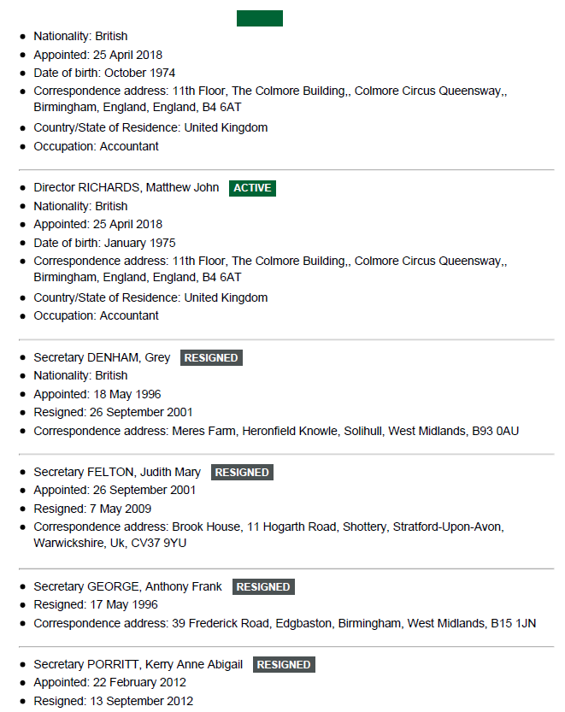
What data would you need to make it work and from whom/where?
Company House Public Datasets including forms, manuals, presentations, etc available with above documents
https://find-and-update.company-information.service.gov.uk/company/00066549

Slide 5
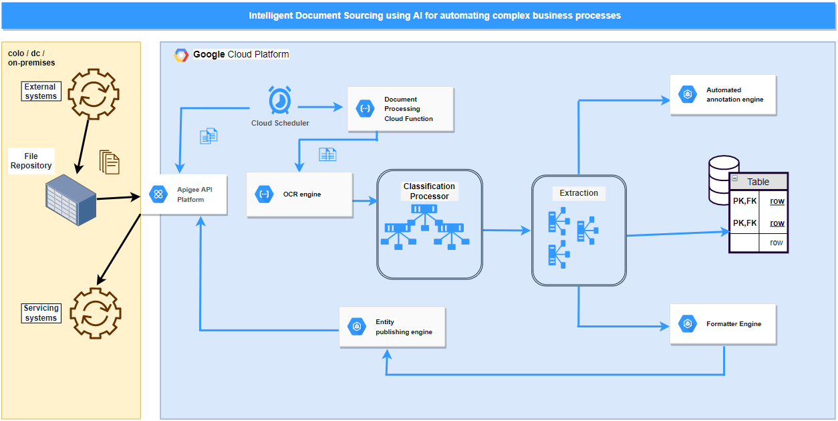
architecture/Solution

Slide 6
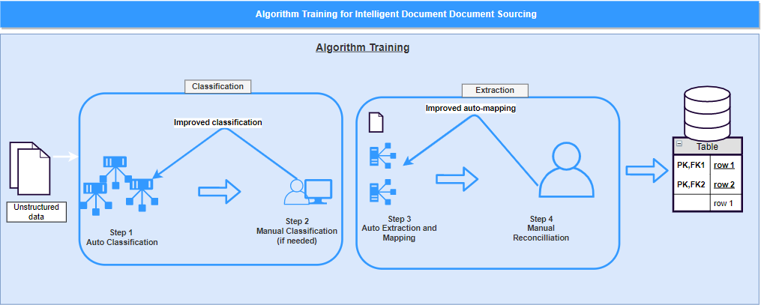
architecture/Solution

Slide 7
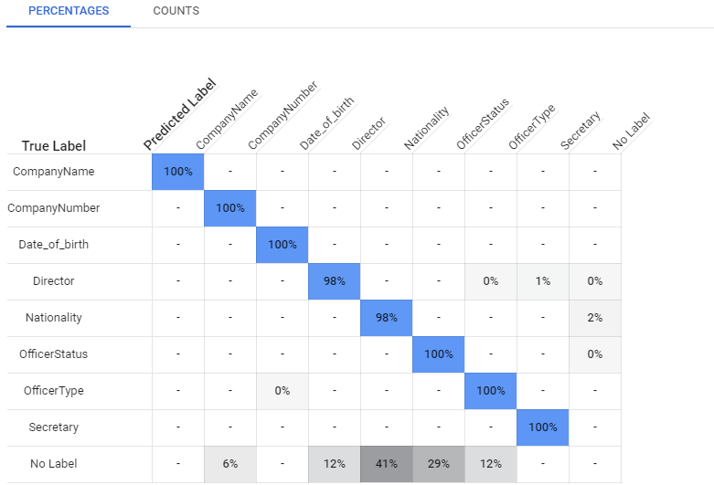
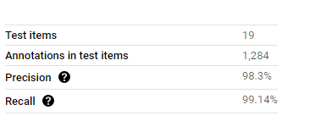
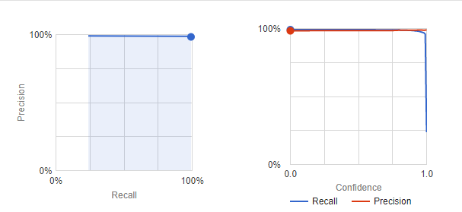
AI ALGORITHM STATISTICS
Precision during training
Confusion Matrix

Slide 8





What impact will our solution have?
Domain independent
Inclusive
Multilingual
Scalable
Cost Effective

Slide 9




cost benefit analysis
Saves around 70% of document generation time.
70% improvement in process capacity
ZERO margin of error
75% cost savings

Slide 10





competing solutions in this space
Notes:
IBM – IBM Automation Document Processing
Newgen Intelligent Document Processing
UI Path Document Understanding

Slide 11



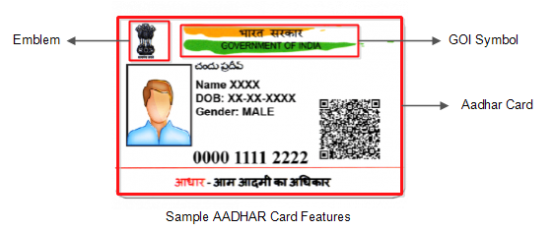

WHAT MAKES US DIFFERENT?
Text to Speech
Chatbot
Support for visually challenged staff members
Helps find required data easily
Annotations
Multilingual
Support for various languages
Highlighting the key fields for easy readability
Confidence Score
Over 99% confidence score achieved that eliminates any false positives/negatives.

Slide 12
Your team composition and member roles
Rajesh Divekar. - Team Lead
Lalit Kumaar Chanchlane. - Architect / Developer
Simarpreet Singh. - Lead Developer
Komal Hukmatani. - Developer
Tania Rajabally. - Developer
Rahul Nair. - Developer

Slide 13
REFERENCES
https://automationedge.com/blogs/robotic-process-automation-rpa-in-banking-industry/
https://assets.website-files.com/5f689f82910c6b4f1ffb855b/611ca5e8e2c55ee88e986bde_BankStatementAutomationGuide.pdf
https://towardsdatascience.com/how-important-is-data-for-your-business-c15a35c6935e
https://home.kpmg/be/en/home/insights/2020/09/ta-key-challenges-of-intelligent-document-processing.html
https://www.thomsonreuters.com/en/press-releases/2016/may/thomson-reuters-2016-know-your-customer-surveys.html
https://datasemantics.co/10-important-banking-processes-to-automate-with-rpa-in-2021/

Slide 14
Thank you

